Slide 1
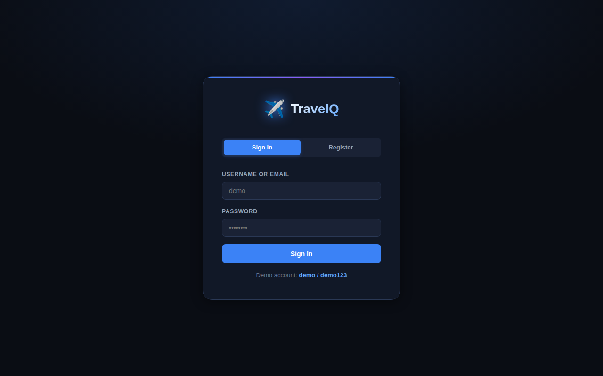
TravelQ
Travel Budget Planner
Submitted by: Swastik Srivastava (CS-23411535)
Guide:
Ms. Yamini Singh, Associate Professor
Department:
Computer Science & Engineering

Slide 2
PROJECT OVERVIEW
TravelQ is a full-stack, single-page web application that helps travellers plan trips, track expenses, manage packing lists, analyse spending patterns, and manage agile workflows through an integrated Kanban board — all without any JavaScript framework.
Core Purpose
Technical Highlights
Unique Features
Trip budget planning
Multi-user isolation
Expense categorization
CSV export
Packing lists
Hand-rolled JWT (RFC 7519)
PBKDF2-SHA256 passwords
Zero external JS frameworks
18 REST API endpoints
SQLite with foreign keys
Integrated Agile/Kanban board
Sprint velocity tracker
11-currency converter
Budget alert system
Full SPA (~2,000 lines JS)

Slide 3
TECHNOLOGY STACK
Python Flask
🗄️ SQLite3
🔐 Custom JWT + PBKDF2
BACKEND
DATABASE
AUTH
Micro-framework REST API. 18 endpoints across 5 domains. JWT middleware decorator on all protected routes.
6-table relational schema. UUID primary keys. Foreign key constraints with ON DELETE CASCADE for referential integrity.
Hand-rolled RFC 7519 JWT using HMAC-SHA256. Passwords hashed with PBKDF2-SHA256, 16-byte random salt, 100,000 iterations (NIST SP 800-132).
🌐 Vanilla HTML/CSS/JS
📋 Scrum / Kanban
💱 11-Currency Converter
FRONTEND
AGILE
CURRENCY
Single HTML file SPA (~2,000 lines). Fetch API for HTTP. Hash-based routing, zero frameworks. Syne + DM Sans fonts.
Sprint management, User Stories with Fibonacci story points, Kanban columns (Todo / In Progress / Done), velocity tracking.
Hardcoded reference rate table for INR, USD, EUR, GBP, JPY, AED, SGD, AUD, CAD, CHF, CNY. Instant conversion.

Slide 4
SYSTEM ARCHITECTURE
PRESENTATION TIER
APPLICATION TIER
DATA TIER
Browser SPA
index.html (~2,000 lines JS)
Flask REST API
app.py (Python)
SQLite Database
travelq.db
Fetch API calls
Authorization: Bearer <token>
Hash-based routing
DOM via innerHTML
18 REST endpoints
JWT middleware
@require_auth decorator
g.user_id isolation
6 tables, UUID PKs
Foreign key CASCADE
PRAGMA foreign_keys=ON
PBKDF2 passwords
HTTP/JSON
JWT Bearer
SQL
Queries

Slide 5
UI WALKTHROUGH · Authentication Screen
Interface Highlights
Login / Register toggle tabs with smooth active state
PBKDF2-SHA256 password hashing (100,000 iterations, random salt)
Custom JWT token generated on successful login — stored in localStorage
Demo credentials pre-filled (demo / demo123) for quick testing
Descriptive error messages for invalid credentials or duplicate usernames
Gradient accent line at top of card — pure CSS, no images

Slide 6
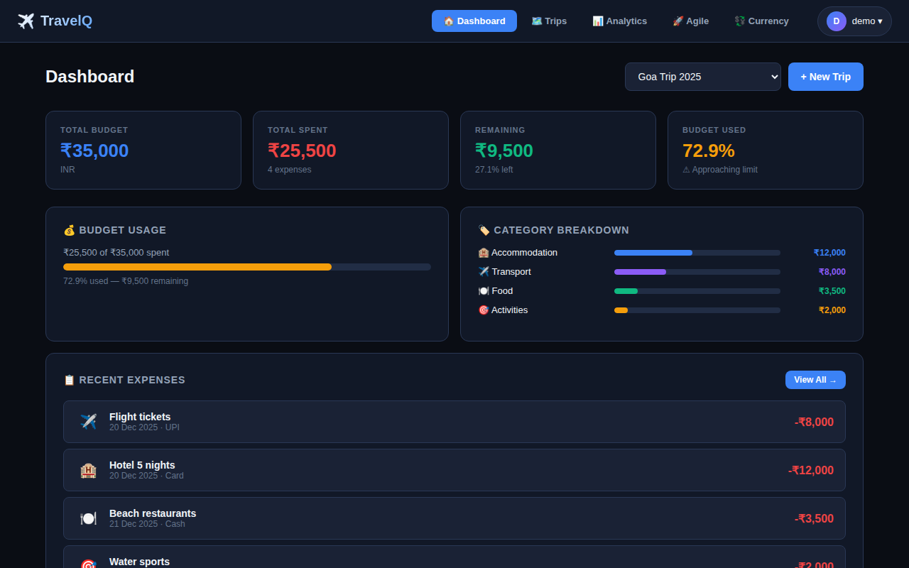
UI WALKTHROUGH · Budget Dashboard
Dashboard Components
4 KPI stat cards: Budget, Spent, Remaining, % Used
Animated budget progress bar — colour shifts amber > 60%, red > 90%
Category breakdown: horizontal CSS bars, no charting library
Recent expenses list with emoji category icon, date, payment method
Trip selector dropdown — instantly switches active trip context
+ New Trip button opens a modal form with budget & date inputs

Slide 7
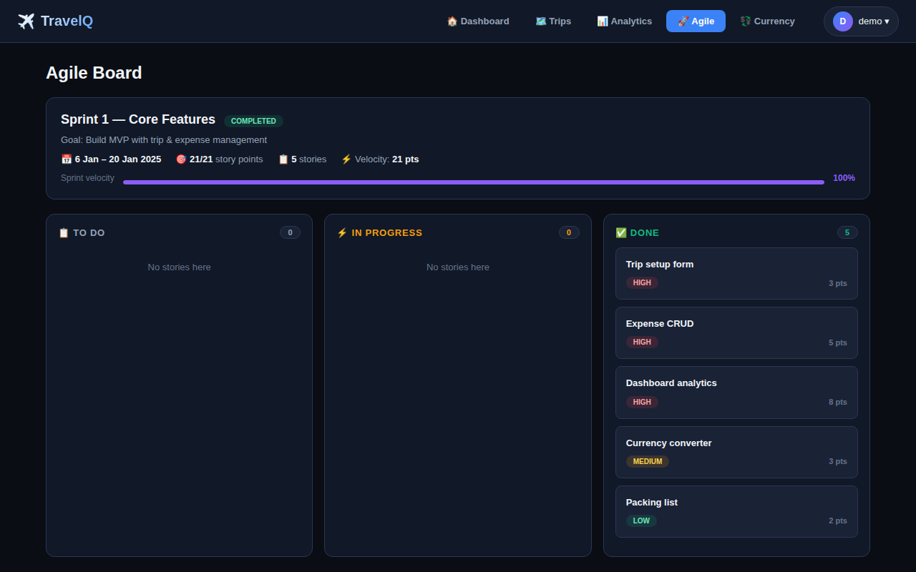
UI WALKTHROUGH · Agile Kanban Board
Agile Board Features
Sprint header: name, goal, dates, velocity, completion %
Three Kanban columns: To Do / In Progress / Done
Story cards show title, priority badge, and story points
Fibonacci story points: 1, 2, 3, 5, 8, 13
Sprint velocity bar showing completed vs planned points
Priority colour coding: red=high, amber=medium, green=low

Slide 8
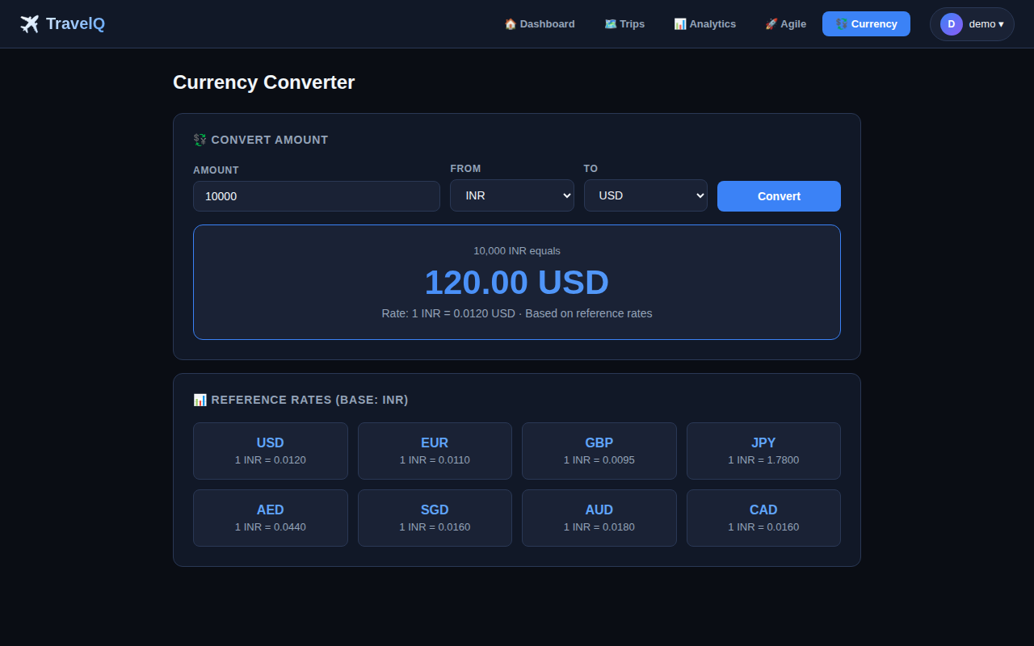
UI WALKTHROUGH · Currency Converter
Currency Module Features
Supports 11 currencies: INR, USD, EUR, GBP, JPY, AED, SGD, AUD, CAD, CHF, CNY
Instant conversion — result displayed with gradient large text
Reference rate grid shows all rates relative to INR base
GET /api/currency/convert?amount=X&from=INR&to=USD endpoint
Rate table updates on each page load from backend /api/currency/rates

Slide 9
DATABASE SCHEMA
users
trips
expenses
id (UUID PK)
username (UNIQUE)
email (UNIQUE)
password (PBKDF2)
full_name
created_at
id (UUID PK)
user_id → users
name, destination
start_date, end_date
budget (REAL)
currency (default INR)
id (UUID PK)
trip_id → trips
name, amount
category, date
method (Cash/UPI/Card)
note
packing_items
sprints
user_stories
id (UUID PK)
trip_id → trips
category, item
checked (0/1)
id (UUID PK)
user_id → users
name, goal
start_date, end_date
status, velocity
created_at
id (UUID PK)
sprint_id → sprints
title, description
priority, status
story_points (Fibonacci)
assigned_to

Slide 10
REST API REFERENCE
Method
Endpoint
Description
Auth
POST
/api/auth/register
Register new user account
No
POST
/api/auth/login
Login, returns JWT token
No
GET
/api/auth/me
Get current user profile
✓
PUT
/api/auth/change-password
Change account password
✓
GET
/api/trips
List all trips for user
✓
POST
/api/trips
Create a new trip
✓
PUT
/api/trips/:id
Update trip details
✓
DELETE
/api/trips/:id
Delete trip + cascade
✓
GET
/api/trips/:id/summary
Budget summary stats
✓
GET
/api/trips/:id/expenses
List trip expenses
✓
POST
/api/trips/:id/expenses
Add expense to trip
✓
GET
/api/sprints
List sprints + stories
✓
POST
/api/sprints
Create new sprint
✓
POST
/api/sprints/:id/stories
Add user story
✓
PUT
/api/stories/:id
Update story status/points
✓
GET
/api/currency/convert
Convert between currencies
No

Slide 11
SECURITY IMPLEMENTATION
JWT Authentication Flow
Security Summary
1
User sends username + password via POST /api/auth/login
Algorithm
PBKDF2-SHA256
2
Server re-derives PBKDF2 key using stored salt → compare_digest
Salt
16-byte random
3
On match: create JWT → Header.Payload.HMAC-SHA256-Signature
Iterations
100,000
4
Token returned to browser → stored in localStorage as 'tq_token'
Standard
NIST SP 800-132
5
All protected requests include Authorization: Bearer <token>
JWT Algo
HMAC-SHA256
6
@require_auth verifies signature + expiry → sets g.user_id
Token TTL
24 hours
Comparison
compare_digest

Slide 12
SPRINT VELOCITY & TESTING RESULTS
Sprint Velocity Tracker
Testing Summary
API Testing
19/20
Planned
Completed
18 endpoints tested with HTTP calls
Verified 200, 201, 400, 401, 404 status codes
JWT: missing, expired, tampered token cases
User isolation: cross-user access returns 403
14/14
5/8
Security Testing
3/4
PBKDF2 brute-force: ~100ms per attempt
JWT tampering → 401 Unauthorized
Token expiry enforced after 24 hours
Sprint 1
Infrastructure
Sprint 2
Trips & Expenses
Sprint 3
Agile & Currency
Sprint 4
UI & Testing
Overall: 41/46 pts — 89.1% completion rate
Browser Testing
Google Chrome, Mozilla Firefox, Edge
All user flows verified manually
SPA routing, modals, form validation

Slide 13
CONCLUSIONS & FUTURE DIRECTIONS
✅ What Was Achieved
⚠️ Limitations
Full RESTful API with Flask — 18 endpoints, proper HTTP conventions
Dependency-free JWT using built-in hmac + hashlib (RFC 7519)
PBKDF2-SHA256 passwords — NIST SP 800-132 compliant
Complete SPA with pure HTML/CSS/Vanilla JS — no framework
Integrated Agile board with Sprint management and velocity tracking
Normalised SQLite schema with foreign keys and cascading deletes
89.1% story point completion across 4 sprints (41/46 pts)
Currency rates are hardcoded, not fetched live
SQLite not suitable for high-concurrency production
No email verification at registration
No ARIA/accessibility attributes on frontend
Not containerised (no Docker compose)
🚀 Future Directions
Live exchange rates via ExchangeRate API
OAuth 2.0 (Google/GitHub social login)
Collaborative trip sharing with RBAC
React Native / Flutter mobile app
Docker Compose + PostgreSQL migration

Slide 14
Thank You
TravelQ — Travel Budget Planner with JWT Auth & Agile Board
Swastik Srivastava · CS-23411535
IILM University, Greater Noida · May 2026
Flask
SQLite
JWT
Vanilla JS
REST API
Agile

